Slide 1

Vault Insurance Claim UI Code Clean-up
Path to Open Source and Enablement
Austin Huang, Principal Consultant, AM, eBaoTech Inc.
9/4/2019

Slide 2
Background
A NEW Challenge
It is true that API is the reason for customer to buy our claim
But the reason that API is the reason is exactly because customer thinks they could own UI, not because they want to connect to external systems or channels. Of course, the potential of connection is a great bonus for them, but not the key reason.
Initially customer would like to develop UI (not external portal or channel connection) based on our APIs from scratch. But after several rounds of demo, they liked our UI. They thought 80% were already there and why reinvent the wheels. They asked whether they could change UI by themselves and we said yes and it was configuration. AND they immediately asked for a demo.
They gave us some cases to change UI in a demo session to showcase the “UI Configuration”. We showed the UI code and changed the code during the demo in front of them to demo that it was very easy to satisfy their requirements. Jeff, Head of Application, was in the demo to make decision of this screening. He was asked in front of us that whether to change the code, instead of configuration, was fine. He responded that it was fine and that for him, it was just different skill set and now he needed UI developers and it was totally fine for him. So we passed this screening.
Later during face-to-face discovery session we struggled with customer suggesting we would own UI in phase I. Marni called in Jeff and both of them stated again that they would like to own UI part. They have prepared 1 UX Designer and 2 React developers for this.
They are implementing Policy Admin system (UNQORK) and they are doing exactly the same thing – develop UI by themselves. They claimed UNQORK UI was really configurable but that is not key.
Another challenge for us is that this Vault IT is running true modern agile process with high standard with below characteristics.
TDD (Test Driven Development) – they explicitly asked us unit test case coverage for our UI code and we responded that we had but might not be at very granularity level
No QA, No UAT – initially they were a little confused when we mentioned this topic and then explained that any project needed a separate QA or UAT was not real agile and that business should not be involved in quality assurance and SPRINT demo WAS the UAT and quality was owned by developers
No maintenance release cycle – No quarterly / monthly maintenance release cycle. They are running true CICD process. Whenever a SPRINT is done with complete feature, they push to production. If no need for shutdown, they push on the same day. If need for shutdown, they push over weekend. They said “why delay value to business”.
Other aspects of agile process are also followed like in textbook
So it is not some 3rd party outsourcing body shops, they are true professionals and expect us to be the same. We have some way to arrive at that status but the challenge on table is UI source code now.

Slide 3
Vault Insurance Claim UI Clean-up Epics
Unit Test Cases
File Level Clean-ups
Structure of Files
Scope of Open Source
Delivery and Training

Slide 4
Scope of Open Source
We do not have to open all UI source code
Customers intension is to revise UI as they wish without counting on vendor – eBaoTech Inc
For now, customers have no intension to change or create APIs
Since customer would like to change ANY UI, I guess we would need to allow customer to change both baseline and project code
We might exclude below from open source scope
Rainbow UI lib – as long as customer could tune UI style WITHOUT touching Rainbow UI code. Customer hired a UX Designer and plan to do so.
Services – this is tightly bound to APIs. We could avoid customer to touch APIs directly by owning this portion. The challenge now is that service files are scattered everywhere and we need to consolidate them as part of epic “Structure of Files”
We need to provide above as installable npm packages

Slide 5
Unit Test Cases
Main Gate to Quality in Agile Approach
Customer is running pure standard agile approach.
So they treat unit testing seriously and take unit testing as main way to guarantee quality. And they are very serious about code coverage.
For our UI technical stack, unit tests shall use Jest and Enzyme from facebook.
We told customer that we have unit tests and reasonable code coverage but may not be at the very small granularity level
The high level approach to unit test cases could be:
Start with top level end-to-end “unit” test cases, following typical smoke test cases. This shall be able to boost up code coverage very quickly. My guess is 60%
We shall use mock-up lib to avoid dependencies to server and make unit tests repeatable
Generate code coverage report and identify hot spots to add more unit test cases. They could be:
Files with less code coverage and more lines than others
More critical business functions / logic branches
The tricky part is how to make unit test cases resilient to UI changes, especially style, label and layout changes, and addition of extra features while existing features are untouched, while still ensure code coverage and the overall business functions working. We would need some principals and samples from senior team:
Define principals on how to isolate surrounding components and context
Define principals on what to assert and what NOT to assert
I rather view this as an opportunity to train people and set up eBaoTech UI unit test culture and approach

Slide 6
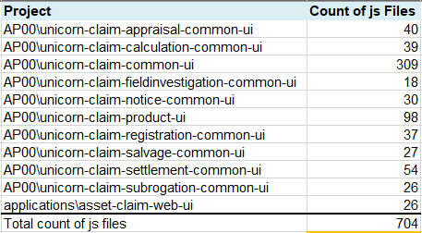
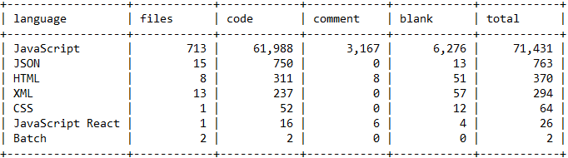
Structure of Files
Easy to Explain and Navigate
I think the overall structure is OK but we might want to review and clean
We do not want to do anything within each file here but just re-organize existing files
We would want to extract Rainbow UI and Services out as separate npm packages which customer is able to install by themselves outside of eBaoTech internal network

Slide 7
File Level Clean-ups
… “reasonably” OK or “deemed acceptable”
We need to deal with issues INSIDE individual files to arrive at “acceptable” quality level
Issue | Solution
Format mess | Batch change with tools like “prettier”
Not follow good coding conventions and so-caused potential bugs | Use static code analysis tool like SonarQube and fix everything, with standard configurations
Security holes | IBM Security AppScan(?) to scan and fix
Confidential information dumped | Define what information is confidential and review API response to ensure no such information dumped to client
Dead code (code never executed) | Review code not covered by unit test from coverage report to ensure they are valid or not
Code with project relevant information like customer or product names | Brainstorm possible names and search. Manually review and remove
No comments or Chinese comments | Write tool to or manually scan and remove all Chinese comments Adopt tools like https://marketplace.visualstudio.com/items?itemName=joelday.docthis to generate JSDoc Manually review and change
[React naïve mistake] Change state not via setState Not use key prop and use index as key Change props Not declare propTypes Call APIs where you should not, like in render Change state where you should not, like in render | Train and manually check and fix

Slide 8
Delivery and Training
How to Give to Customer and Then What?
README – install, configure, compile, deploy
Share via github or something else?
We still own the repository, or…
Customer forks out and do by their own? If so …
Can we take it back?
Npm package for Rainbow UI and Services and how to enable customer to access outside of eBaoTech
Environments?
How customer compile and deploy the code in various environments
eBaoCloud Container Service Factory?
Training: format?
How and who shall continuously support customers on this?

